Slide 1

FitApp Phase 1 Review
FitApp| Team 6 | CS 473/673 SW-ENG Fall 2015

Slide 2
FitApp Overview
Team 6 is creating a website which will input health and fitness data
Will provide a means for tracking and analytics of that data.
Will complement fitness hardware (Fitbit, jawbone pedometers) and fitness planning for general use.
Process
Waterfall Model
Tools: GitHub, Google Drive, Trello, Email, Ubuntu VM, HTML, CSS, Node.js, MongoDB, jQuery
Phase: Development
Meet: Weekly in the library. Constant communication via email.

Slide 3
What we have accomplished:
Project Management (Genevieve)
Set up communication, tools, tracking, version control
Project proposal, risk assessment
Requirements (Amal)
5 Main Functional Requirements
Database (Ian)
Development Environment (Will)
Front End (Jiachen/Rasha)
Wireframes, Sitemap, Web Design
HTML/CSS Skeleton, home page, signup page
Back End
Node.js setup
Node.js server code
MongoDB hosted

Slide 4
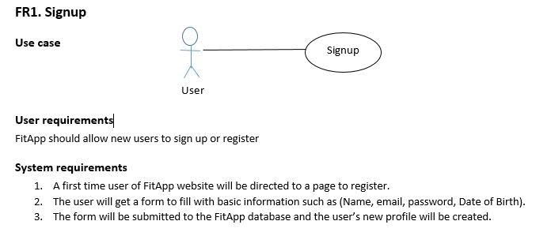
Requirements (Rasha)

Slide 5
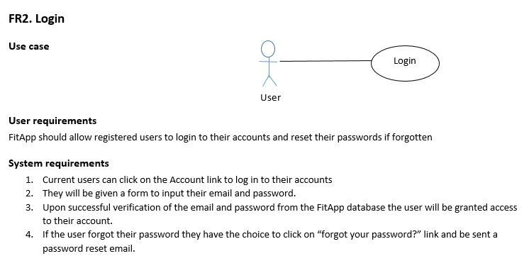
Requirements

Slide 6
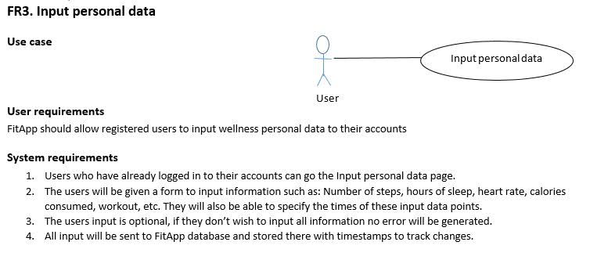
Requirements

Slide 7
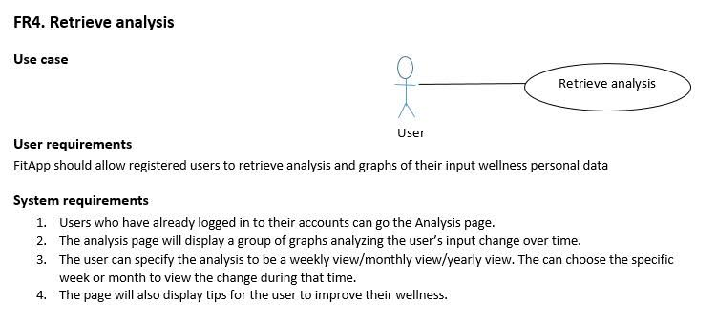
Requirements

Slide 8
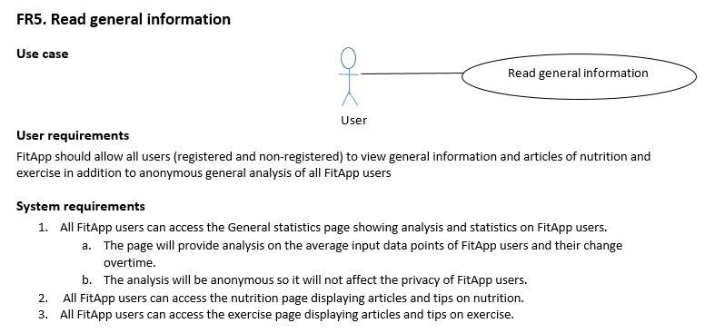
Requirements

Slide 9
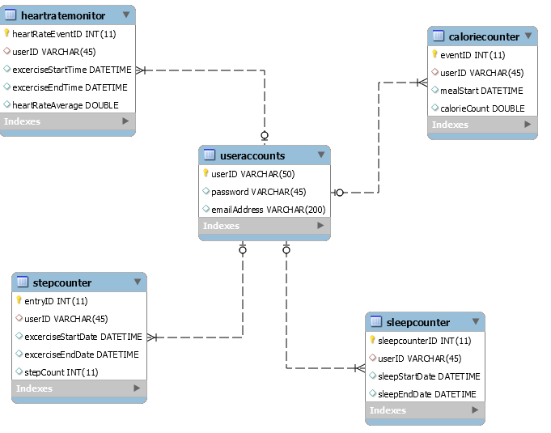
Database Summary (Ian)

Slide 10
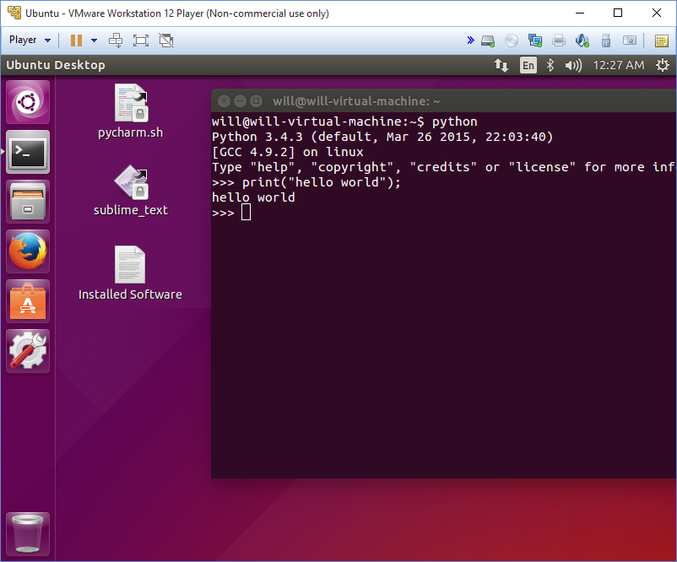
Development Environment (Will)

Slide 11
Issues Summary (Genevieve)
CLOSED: Turnover – a member dropped the course, and a new member joined.
CLOSED: Back End technology/tools decision (chose node.js and mongoDB).
OPEN: Back end implementation (undergoing training via internet tutorials and Jiachen’s sample code).
OPEN: Database design and migration (designed for MySQL, but we are transitioning to MongoDB).

Slide 12
Site Demonstration
Jiachen: http://localhost:3000/
Rasha: Project Files\fitapp\fitapp\index.html

